Slide 1





FSD PRESENTATION
Util Module in Node.js
Presented by:-
NAME:-A.AJAY
ROLL NO:- 22H51A05D2
SECTION:- CSE-D

Slide 2

I ntroduction
The util module in Node.js provides various utility functions that help developers perform common tasks more easily.
It includes functions for debugging, formatting, and working with objects and other data types.
While some of its functions are now considered legacy and have modern alternatives, the util module remains a useful tool for specific use cases.

Slide 3

Basic Information About the util Module:
1. Loading the util Module
To use the util module in your Node.js application, you first need to require it:

Slide 4

2. Core Functions of the util Module
util.format():
Formats a string similarly to how printf works in C.
It replaces placeholders (like %s, %d) in a string with corresponding values.

Slide 5
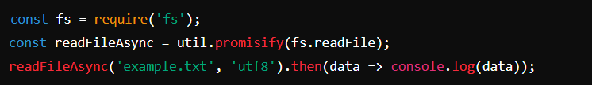
util.promisify():
Converts callback-based functions to Promise-based, allowing the use of async/await.
Very useful for modernizing code.

Slide 6
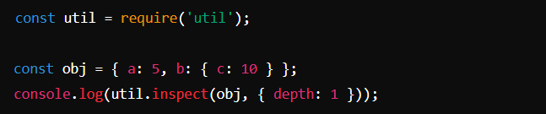

util.inspect():
Used for printing and inspecting JavaScript objects, making them easier to read and debug.
It can display hidden properties and manage how deep the inspection goes.
output:-

Slide 7
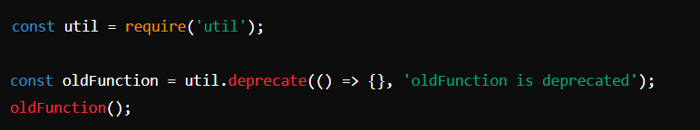
util.deprecate():
Marks functions as deprecated and issues a warning when they are used, signaling to developers that they should use alternative methods.
output:-

Slide 8
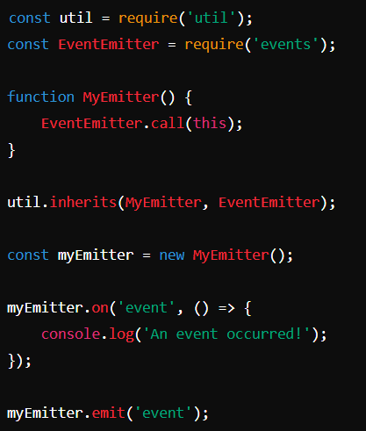

util.inherits():
Allows for classical inheritance by setting up the prototype chain.
Typically used to inherit from the built-in EventEmitter.
output:-

Slide 9
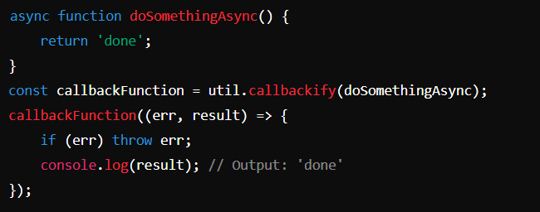
util.callbackify():
Converts a Promise-based function back into a callback-based function.
Useful for working with older code that relies on callbacks.

Slide 10
Use Cases
Debugging: util.inspect() is commonly used to print complex objects during debugging.
Migration: util.promisify() and util.callbackify() help in migrating between callback and Promise-based code.
Deprecation Warnings: util.deprecate() is used to inform developers that certain functions or features will be removed or should be avoided.
Type Checking: Although basic type checking can be done using typeof, the util module provides more specific checks (e.g., util.types.isDate()).

Slide 11
Conclusion
The Util module in Node.js is a powerful tool that can greatly enhance your development workflow. By leveraging its utility functions, conversion tools, and debugging features, you can write more efficient, maintainable, and reliable code.

Slide 12
Thank
You

